Slide 1
Framework for Evaluating an IC’s Resiliency to Fabrication-Time Attacks (U)
Tim Trippel
Summer Research Intern – Final Presentation
August 29th, 2017
Notes:
1
1

Slide 2
About Me
Purdue University
BS in Computer Engineering
University of Michigan
MSE in Computer Science Engineering
PhD in Computer Science Engineering
Focus in Hardware Security
Author of the “WALNUT” paper on controlling MEMS accelerometers with acoustics
Worked under Matthew Hicks & Kevin Bush

Slide 3
Overview
Motivation
Problems
Preparation
Approach
Design
Results
Future Work

Slide 4
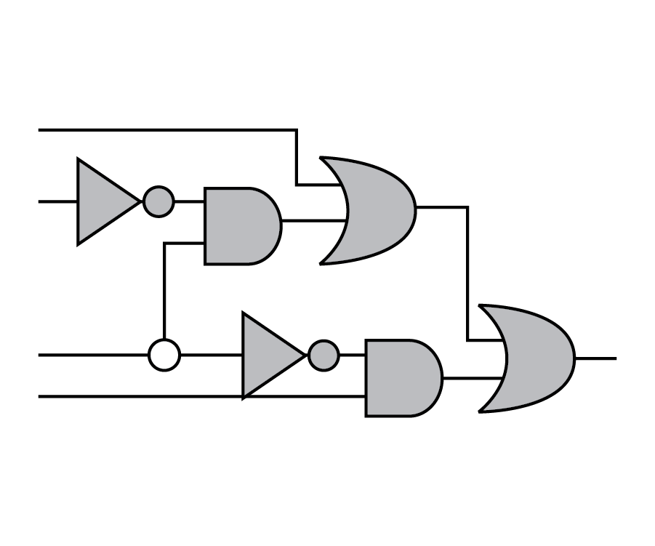
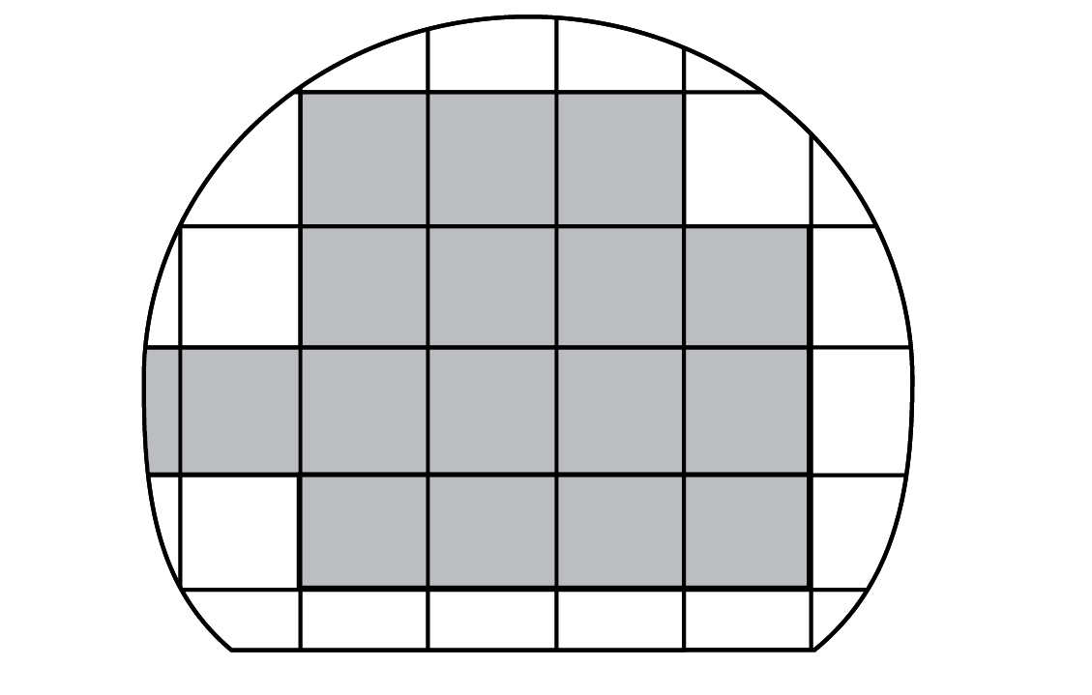


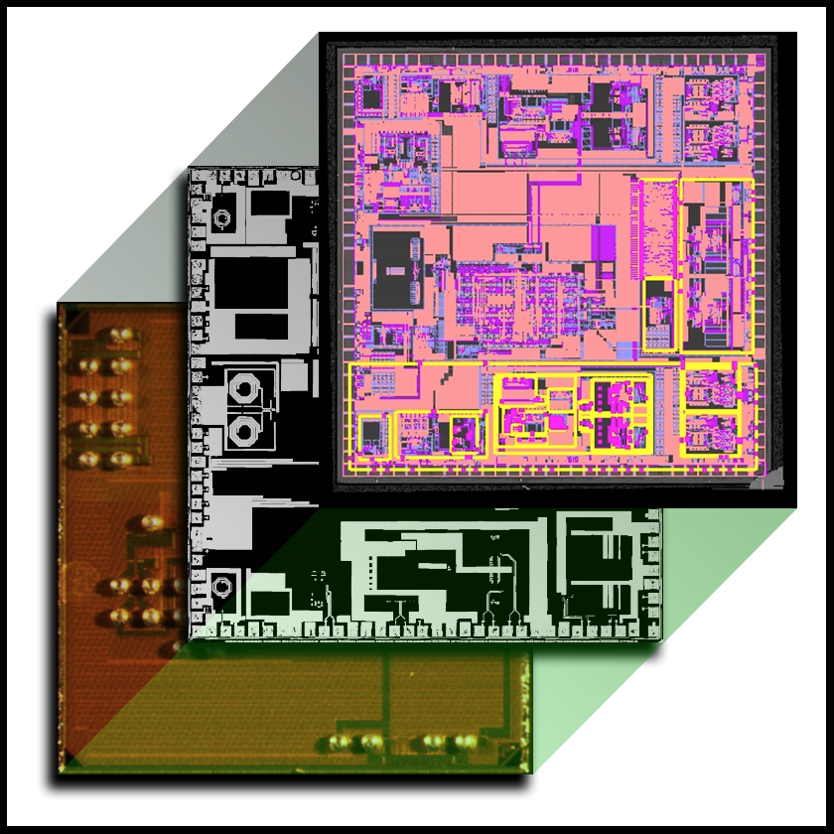
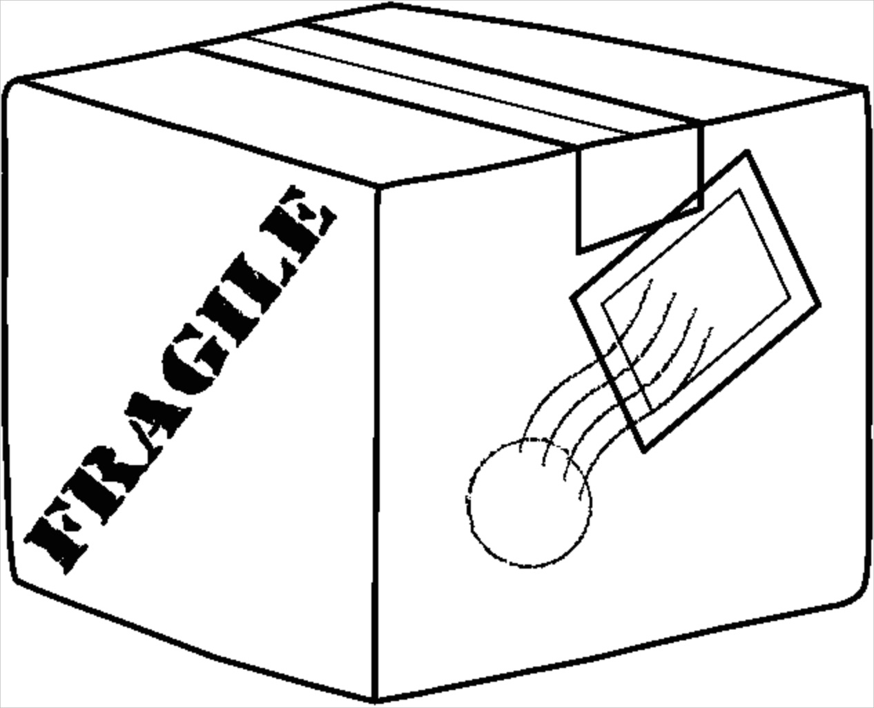
Motivation
Hardware Supply-chain Security
Design Phase
Manufacture Phase
3rd Party IP
Untrustworthy Source
Untrustworthy Designers
Untrustworthy Tool Chain
Untrustworthy Foundry
Untrustworthy Delivery
Front End
Malicious design flaws
Back End
Malicious deviations from a trusted design

Slide 5
Motivation
Assuming one CAN create trustworthy IC designs, how can you guarantee the fabrication of these designs at untrusted foundries?
Until 2016, hardware Trojans demonstrated in literature were easily detectable
Trigger circuits too sophisticated → easily detectable via physical inspection/side channels
Trigger circuits too simplistic → easily detectable via post-fab testing
Oakland 2016 best paper (A2: Analog Malicious Hardware) demonstrated how a sophisticated trigger circuit could be crafted out of analog components at fabrication time making it stealthy enough to avoid detection.
Design Phase
Manufacture Phase
Trusted
Untrusted

Slide 6
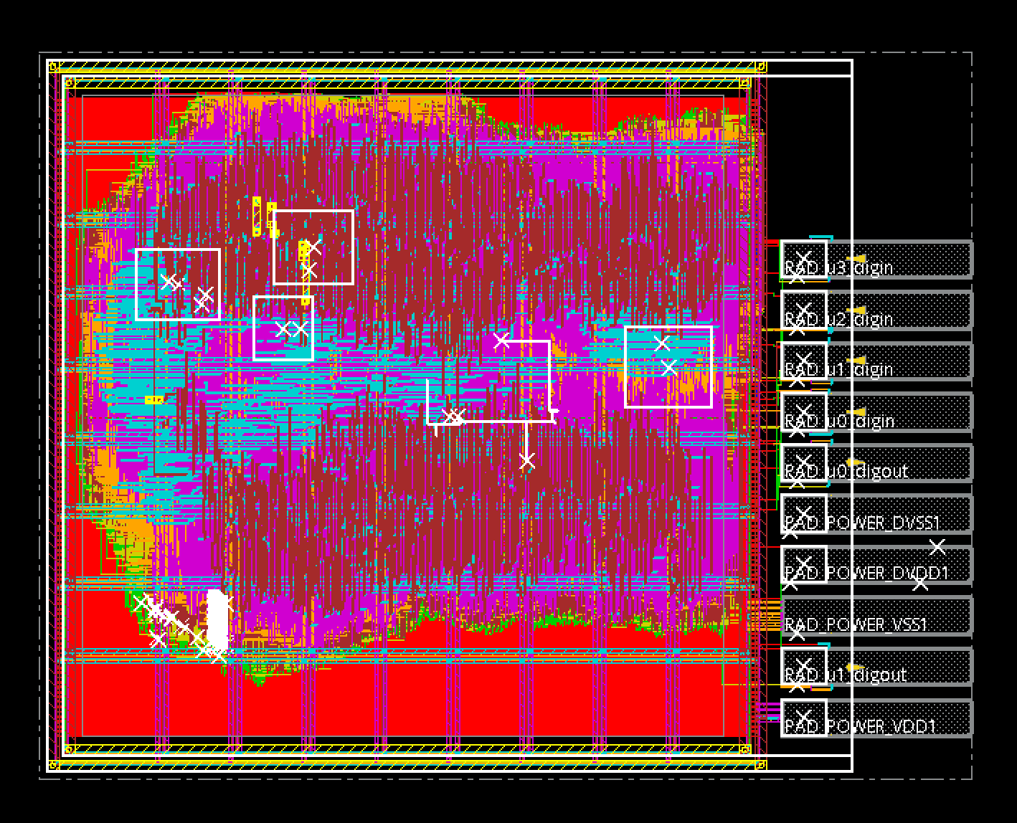
Preparation
To study fabrication time attacks, must work with real IC design:
OR1200 Open Source Processor SoC (same as A2 paper)
Designed using 45nm ARM and IBM standard cell and I/O cell libraries
Synthesized with Cadence Genus v16.23
Placed and Routed with Cadence Innovus 17.1

Slide 7
Problem
How do we deal with stealthy fabrication-time attacks?
Detection
Stochastic Backside Imaging – image only areas of chip where Trojan is likely to be
Prevention
Defensive Layout – make it difficult for an attacker to insert the Trojan to begin with
Need a framework to evaluate how difficult it is to insert Trojans at fabrication time
How do we identify security critical nets in a design?
How do we evaluate how difficult it is to attach a rogue wire to a critical wire in a design?
IC
Trojan Circuit
rogue wire
security-critical wire
Notes:
Obfuscation – make it difficult to reverse engineering to find security-critical wires

Slide 8
Approach
ASIC Design Flow
RTL
Synthesis
Place & Route
Fabrication
Verilog
RTL
Verilog
Netlist
GDSII
Framework Tool Flow
GDSII
Verilog
Netlist
Nemo
GDSII-Score
Critical
Nets
Security
“Score”
Signal
Prefix

Slide 9
Design
Identifying Security Critical Nets in a Design
Assume: RTL designer has appended a specific prefix to “security critical” signal names in a design
Problem: Given this, how can we identify the “fan-in” to these security critical signals?
Solution: Nemo – a Verilog compiler back-end that outputs signal dependency graphs
ASIC Design Flow
RTL
Synthesis
Place & Route
Fabrication
Verilog
RTL
Verilog
Netlist
GDSII
Nemo Tool Flow
Verilog Netlist
(from synthesis)
Nemo
Critical Signal Dependency Graph
Critical Sig Prefix
Nemo has been open-sourced: https://github.com/mit-ll/nemo

Slide 10
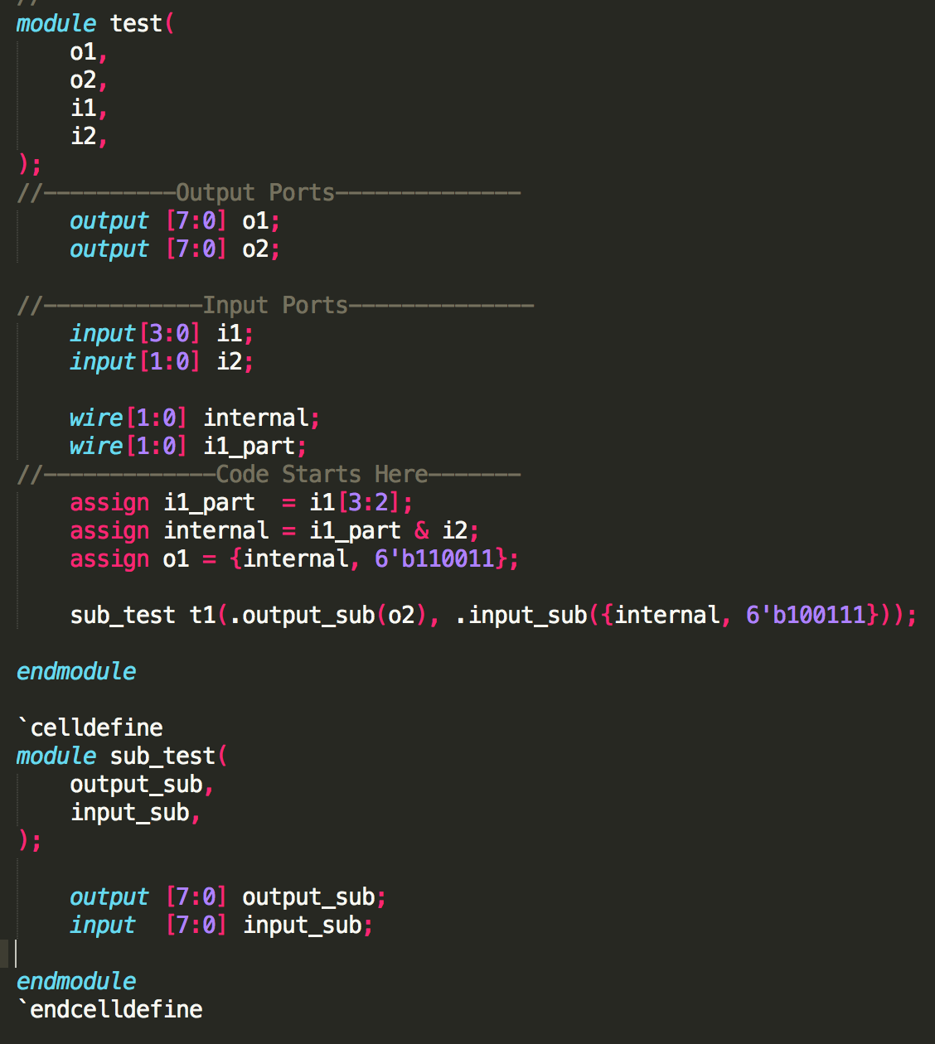
Design
Nemo Example Usage
Nemo INPUT
(Synthesized Verilog Netlist)
Nemo OUTPUT
(Graphviz .dot file)
Nemo

Slide 11
Design
Evaluating the Difficulty of Attaching Rogue Wires to Critical Wires
Problem: Given a list of wires (output from Nemo), how can we identify how difficult it is to attach a rogue wire to one?
Solution: GDSII-score – an automated framework for analyzing the layout of specific nets in a GDSII file
ASIC Design Flow
RTL
Synthesis
Place & Route
Fabrication
Verilog
RTL
Verilog
Netlist
GDSII
GDSII-Score Tool Flow
GDSII
GDSII-Score
Report
Critical Signal Dependency Graph
(Nemo Output)
GDSII-Score will be open-sourced soon!

Slide 12
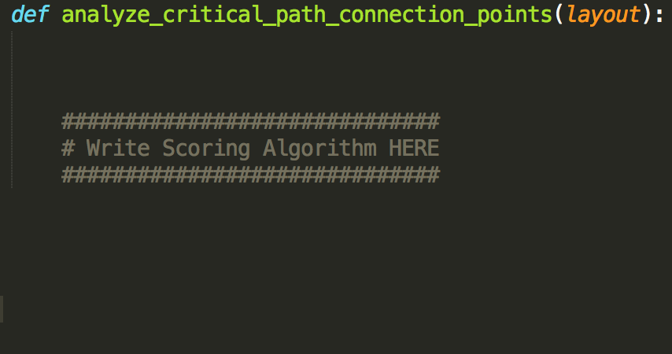
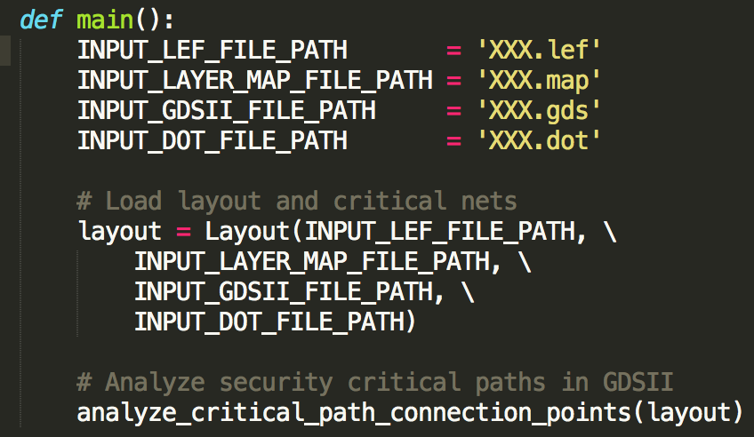
Design
How does GDSII-Score Work?
GDSII-Score is an exstensible Python framework for analyzing security-critical path objects (wires) in a GDSII file.
class Layout():
LEF() – stores info about design rules
GDSII() – stores the GDSII data structures
CriticalNets() – Stores a list of security critical nets to examine (Nemo output)

Slide 13
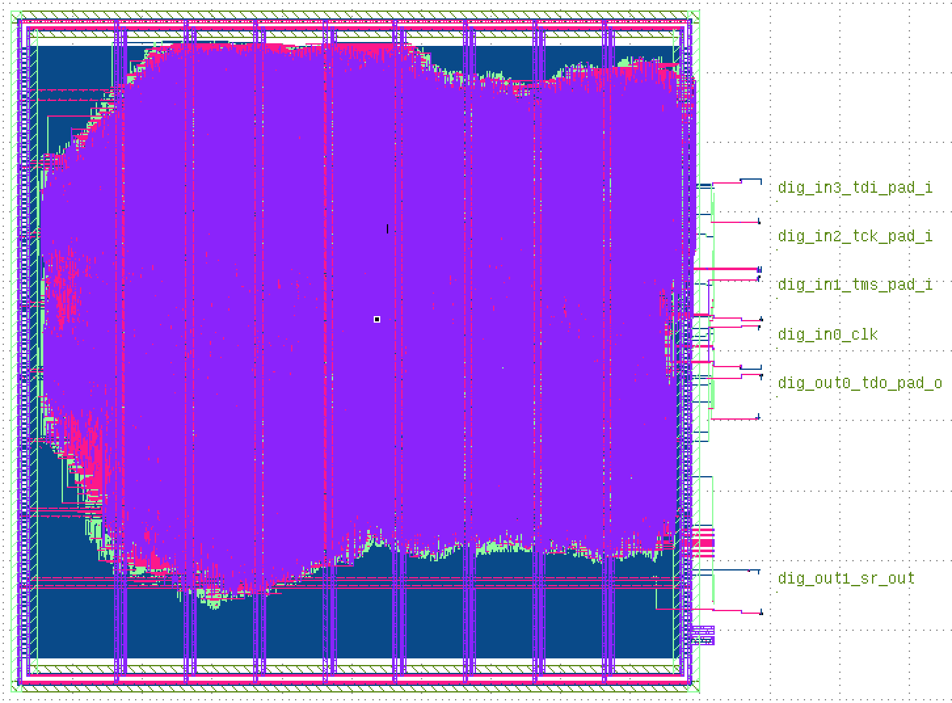
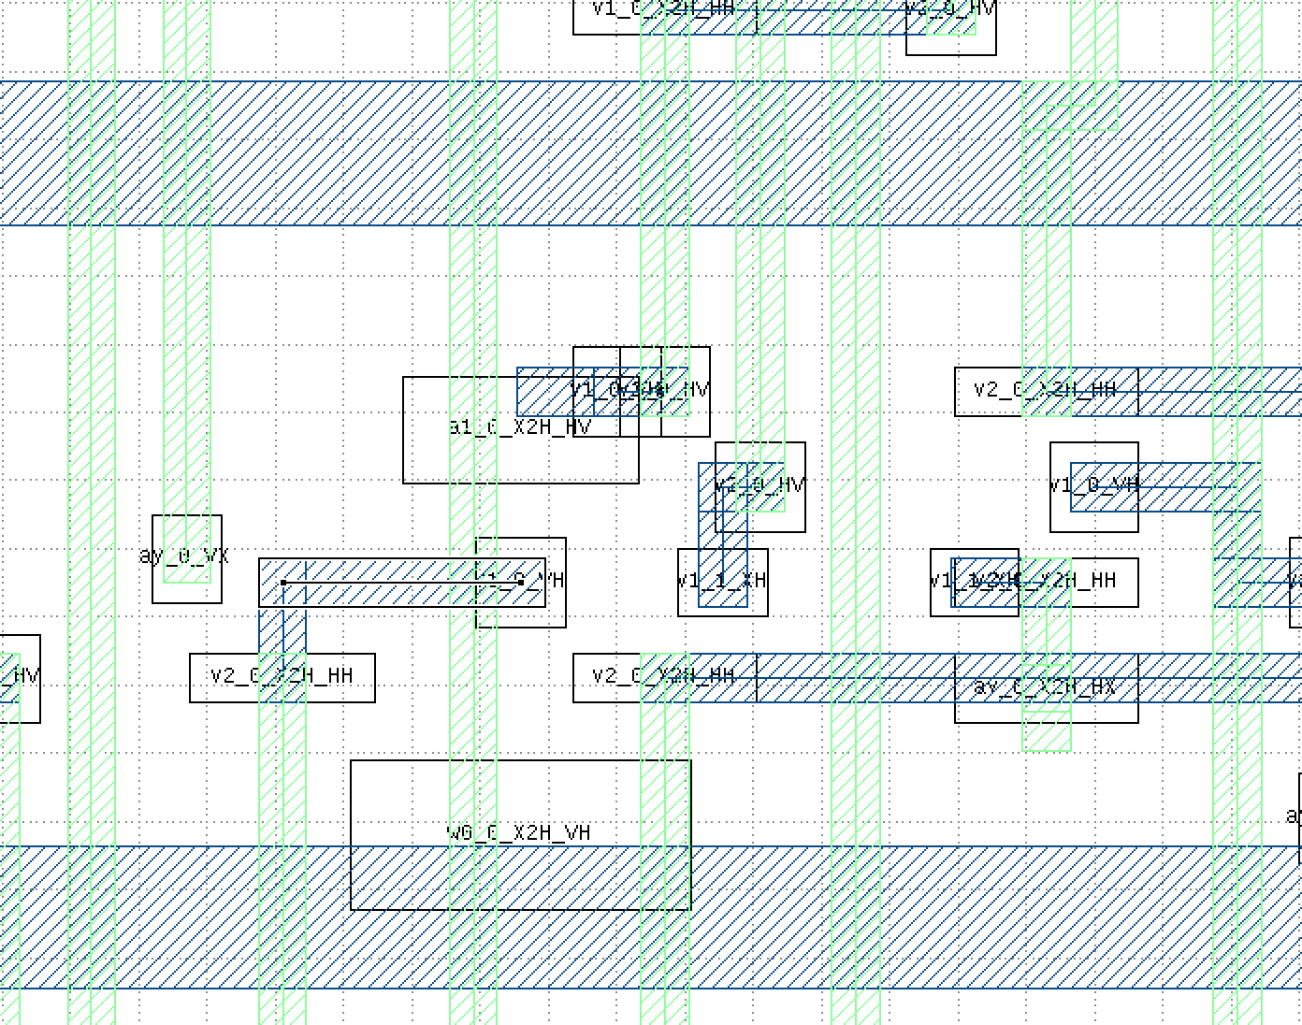
Design
Example GDSII-Score Metric: Calculating Wire Blockage
Report:
Critical Net 1 is 65% Blocked
Notes:
As we approach smaller technology nodes there are more design rule constraints

Slide 14
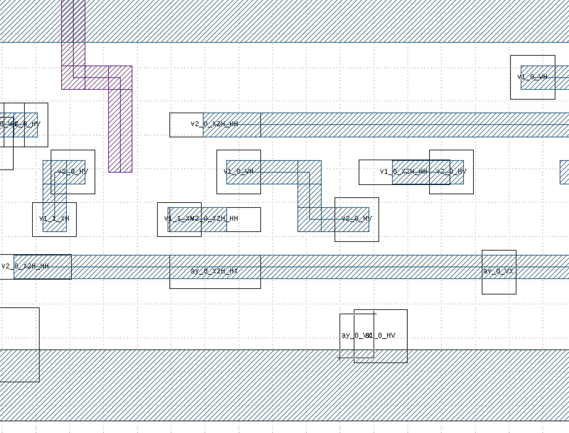
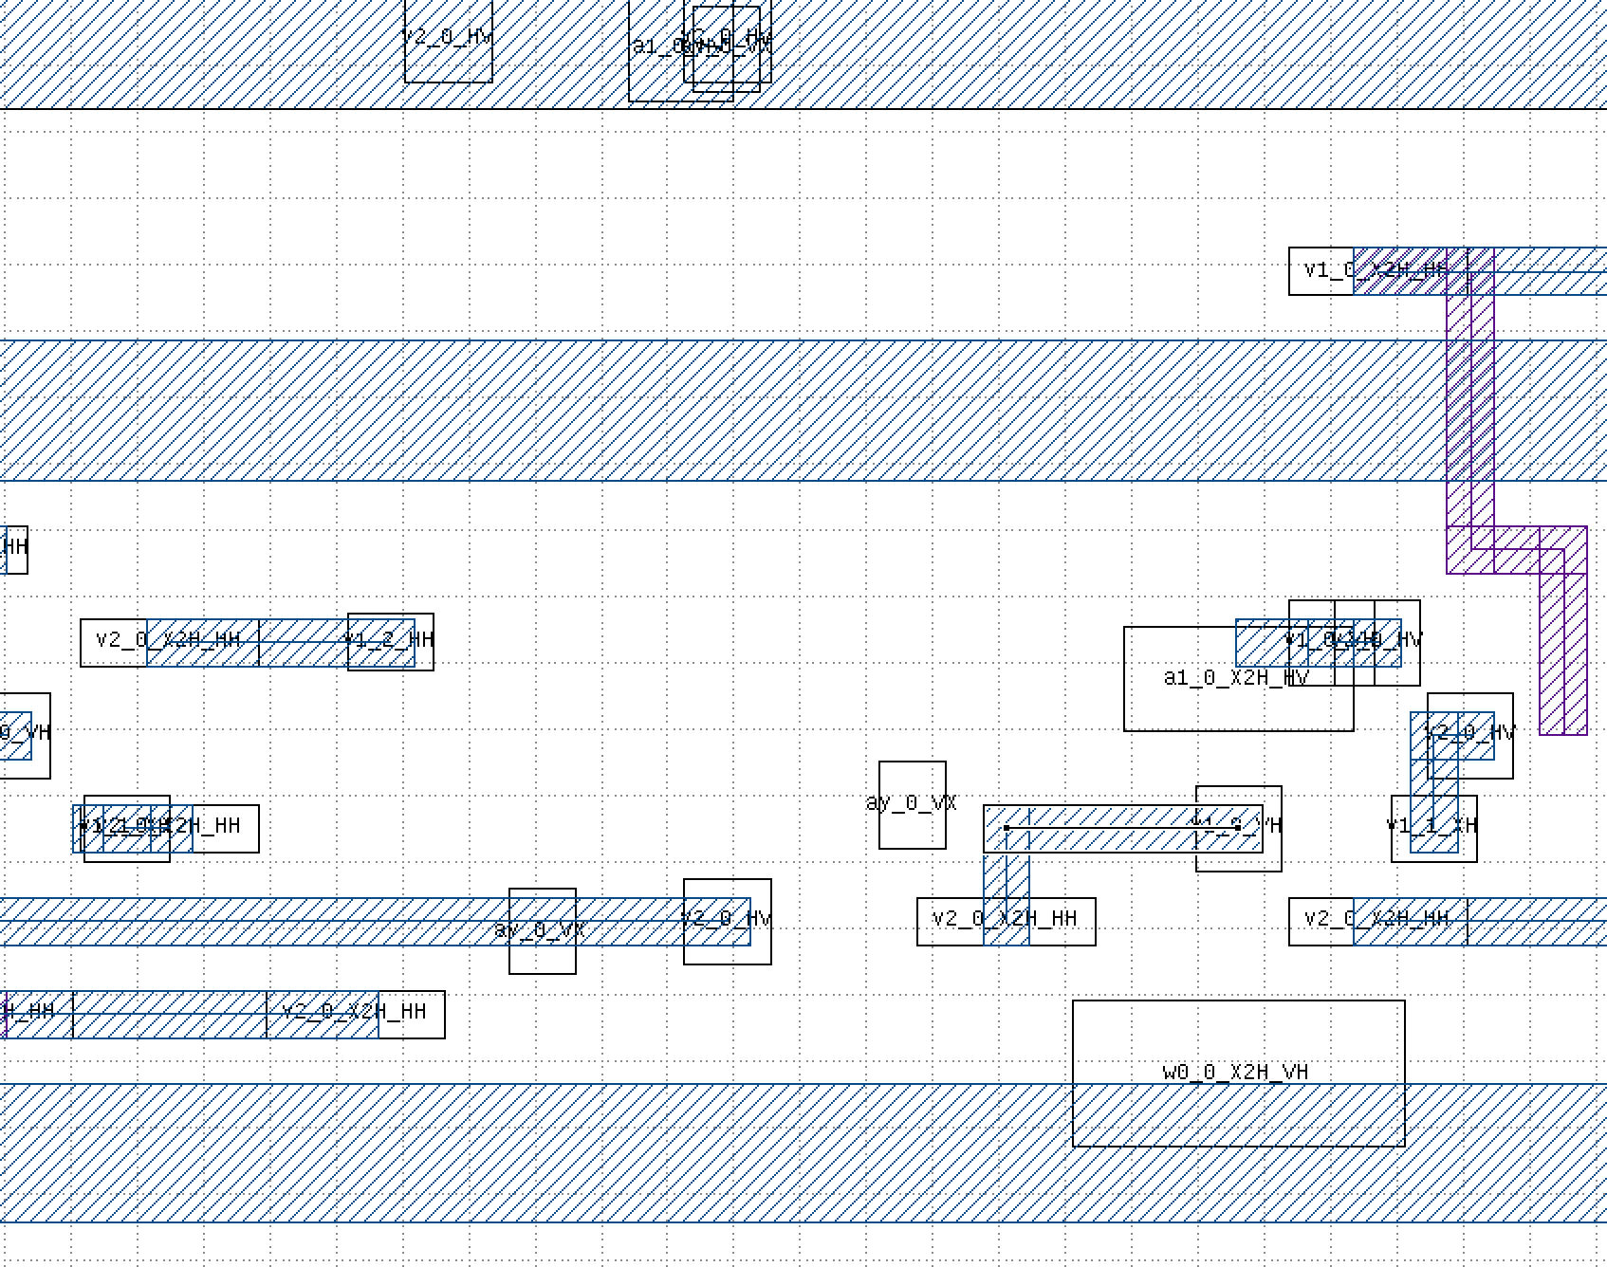
Design
Other GDSII-Score Metrics
Edit Distance
Open Space for Implant
Notes:
Edit distance
Spider method

Slide 15
Future Work
Oakland (IEEE Security and Privacy)
Submit this work
Usenix Security
Submit work on a “Defensive Layout” technique driven by this framework to make inserting Trojans at fabrication time very difficult
Automate the generation of place & route tool scripts to maximize the “security” rating provided by the framework discussed today
Notes:
Open questions:
How automate detection of security-critical signals
Advances in gds2-score metrics
Def. PnR – auto gen of critical paths
Imaging – generation of a distribution for image samplinge

Slide 16
Future Work
Nemo + GDSII-Score Framework
(Oakland 2018)
Stochastic Backside Imaging
(?)
Defensive Layout
(Usenix 2018)
Notes:
Open questions:
How automate detection of security-critical signals
Advances in gds2-score metrics
Def. PnR – auto gen of critical paths
Imaging – generation of a distribution for image samplinge

Slide 17
Future Work
Open Questions/Tasks:
How to automate selection of security-critical nets?
Developing more advanced GDSII-Score metrics.
Use the framework to auto-generate place-&-route scripts that add “guard-wires” to sensitive nets
Use the framework to produce a sampling distribution of high-valued locations on an IC to image.
Notes:
Open questions:
How automate detection of security-critical signals
Advances in gds2-score metrics
Def. PnR – auto gen of critical paths
Imaging – generation of a distribution for image samplinge

Slide 18
Acknowledgements
Mentors:
Matt Hicks
Kevin Bush
Group 81:
Ted Lyszczarz
Brian Tyrrell

